Slide 1
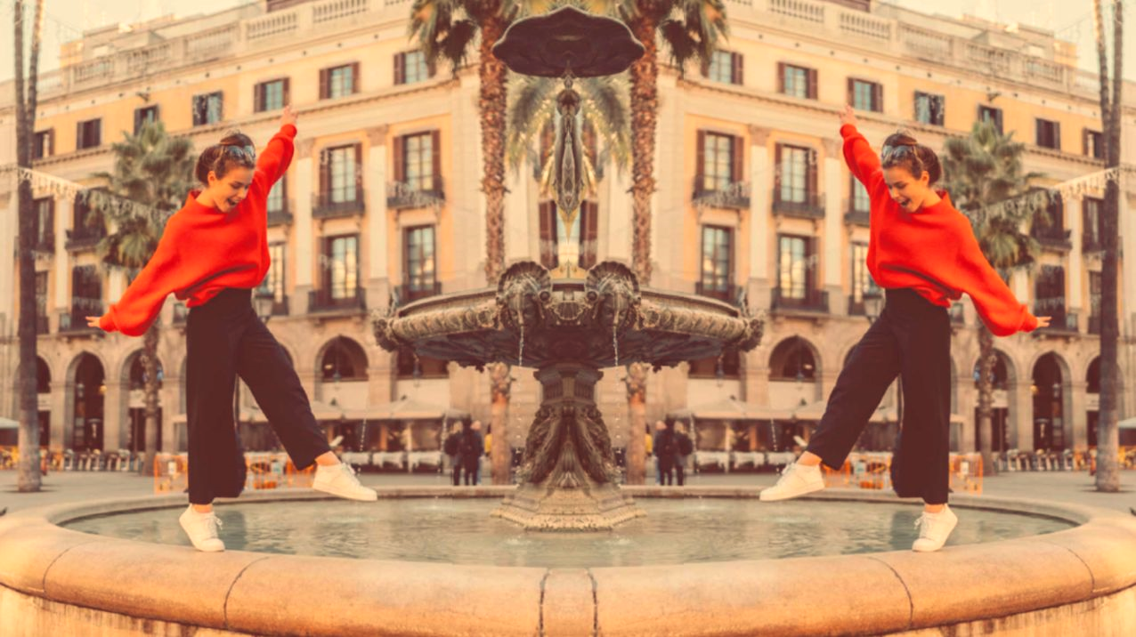
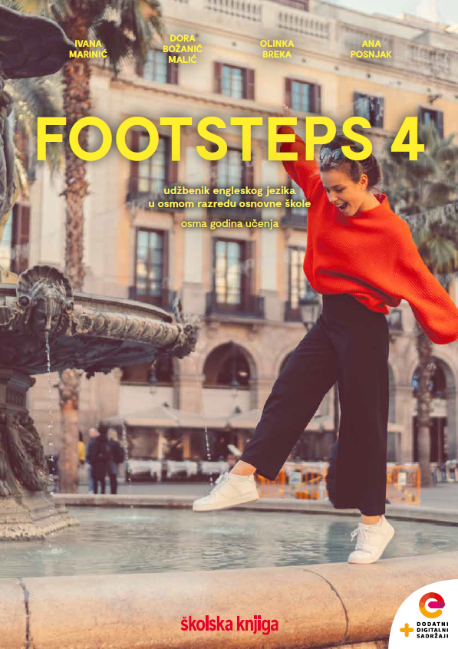

UNIT 2;
Inspired
Lesson 1; The right-brained ones

Slide 2
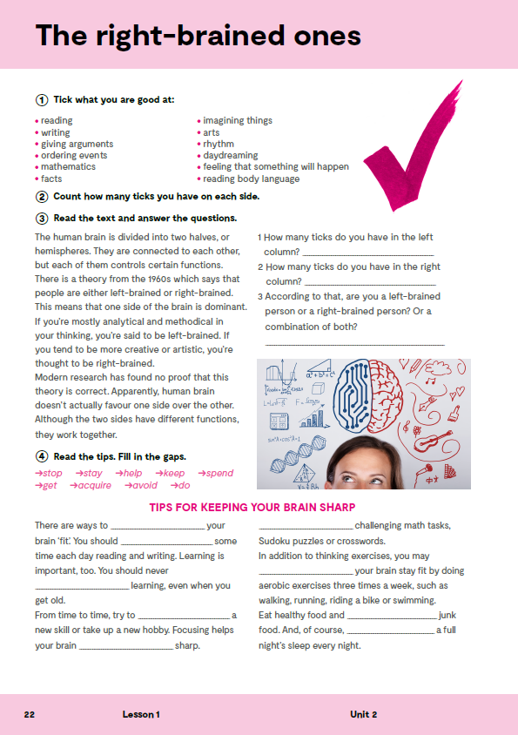
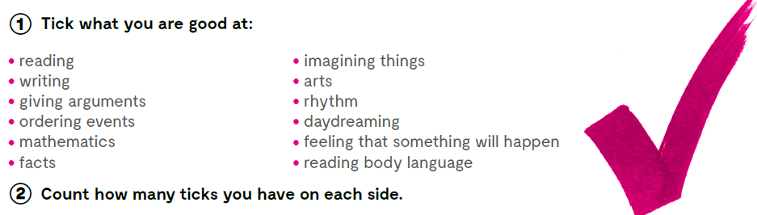
Tick what you are good at!
Count how many ticks you have on each side.

Slide 3

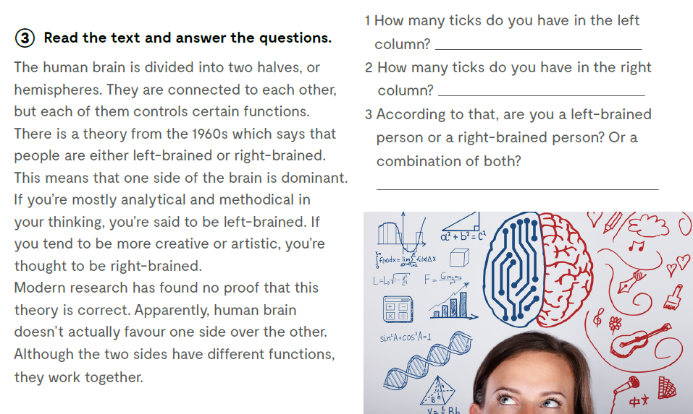
Read the text and answer the questions.
How many ticks do you have in the left column?
How many ticks do you have in the right column?
According to that, are you a left-brained person or a right-brained person? Or a combination of both?

Slide 4
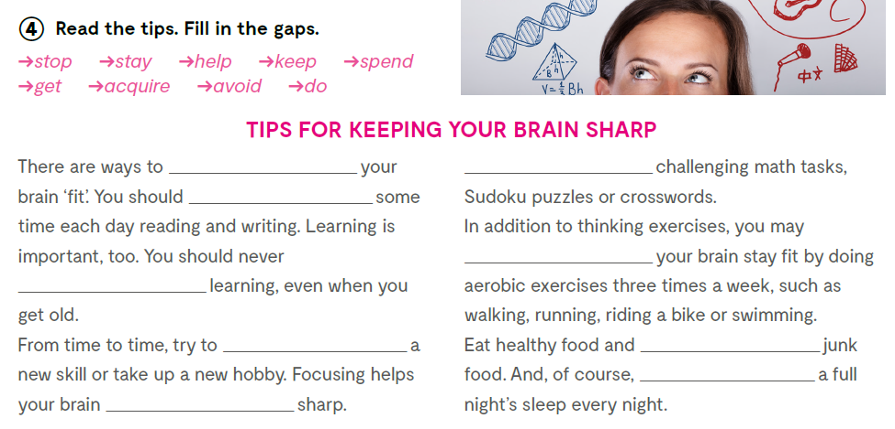
keep
Do
spend
help
stop
acquire
avoid
get
stay

Slide 5
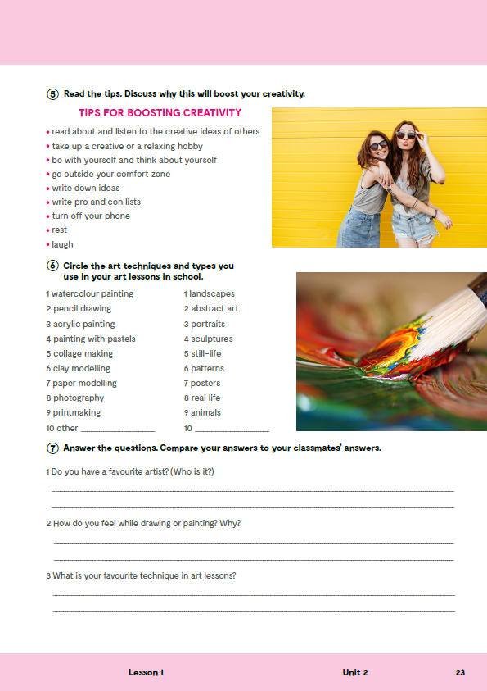
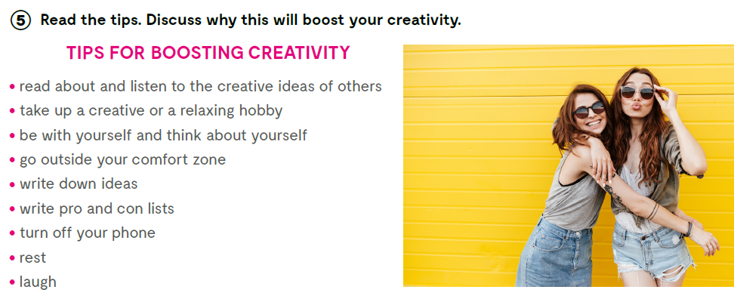
In task 5, on the next page of your exercise book read the tips and discuss why this will boost your creativity.

Slide 6

Open the following link and then click on LEARN MORE!
https://www.e-sfera.hr/dodatni-digitalni-sadrzaji/86d8aea3-689a-4c83-b23a-236d1d1fb4d5/
Care for your brain
Read the text. Did you know all that?
Do the tasks bellow the text.

Slide 7
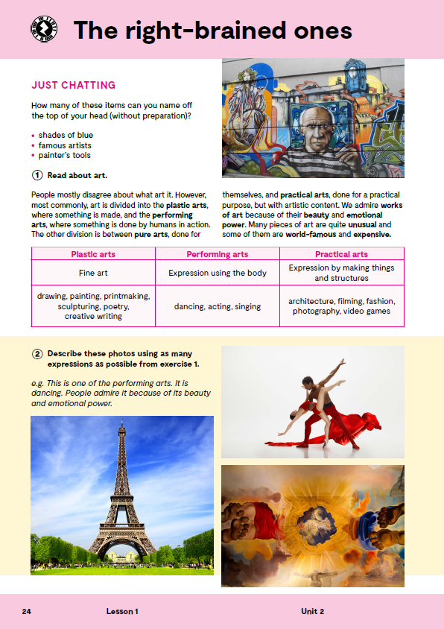
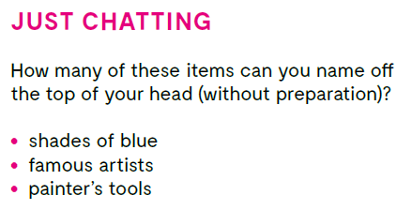
Do you know the meaning of these expressions?
How many of these items can you name off the top of your head (without preparation)?
- shades of blue
- famous artists
- painter’s tools
umjetničko djelo
umjetničko djelo
autoportret
ulje na platnu
mrtva priroda
crtež
vodene boje
pejzaž
skulptura
tiskara
slika
work of art
piece of art
self-portrait
oil on canvas
still-life
drawing
watercolour
landscape
sculpture
printmaking
painting

Slide 8

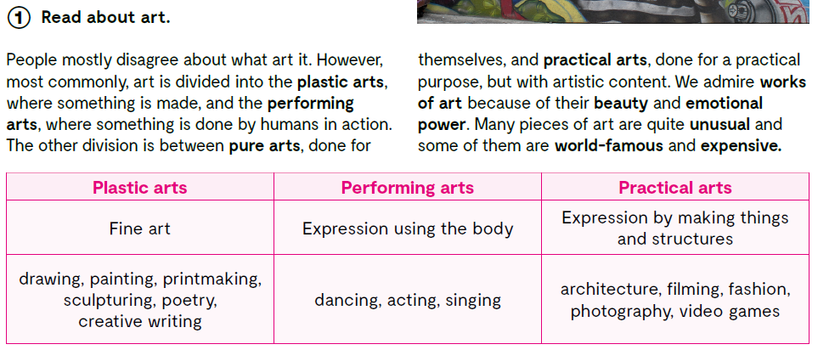

Slide 9

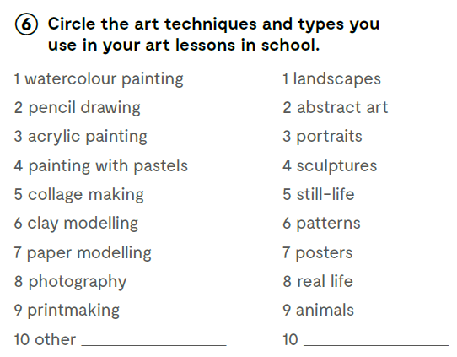
Circle the art techniques and types you use in your art lessons in school.
Which one is your favourite?
What do you enjoy doing in your art lessons?
Do you consider yourself to be an artist/a creative person?
Check what you have learnt:
https://wordwall.net/play/11723/485/351
https://wordwall.net/play/11724/520/537

Slide 10

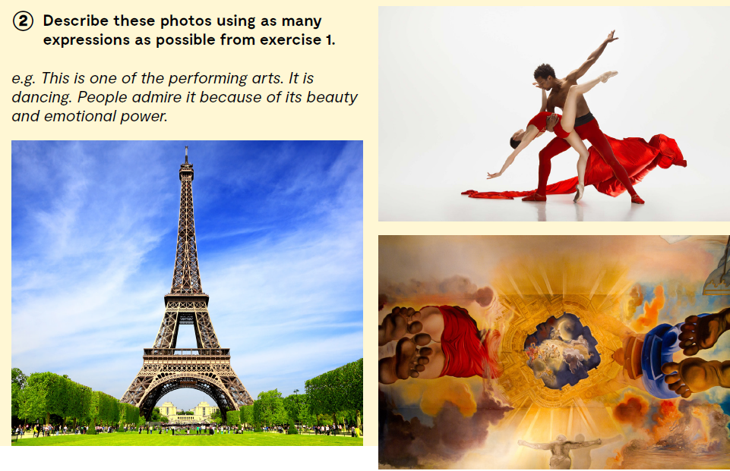
Describe these photos using as many expressions as possible from exercise 1.

Slide 11
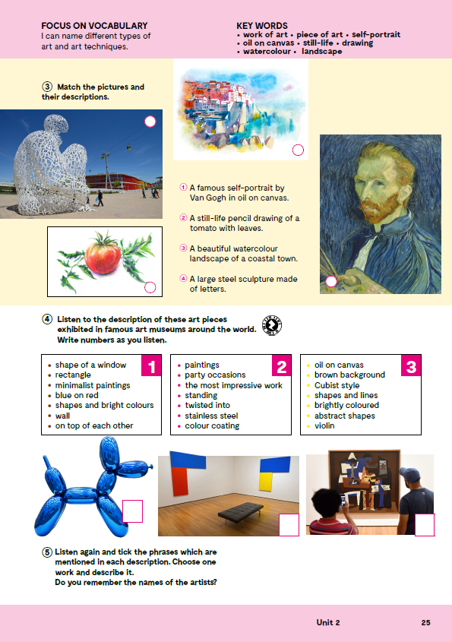
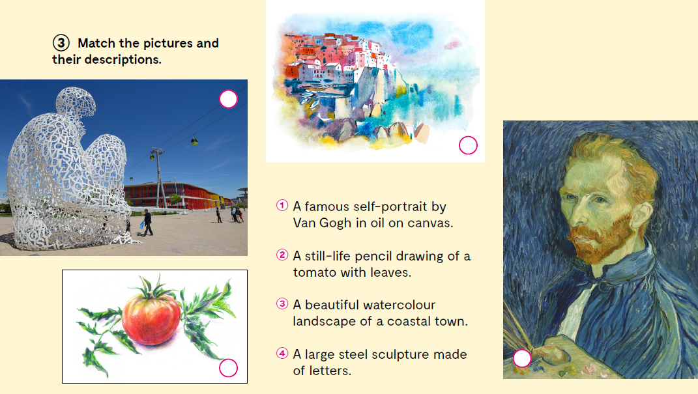
Match the pictures and their descriptions.
4
3
2
1

Slide 12


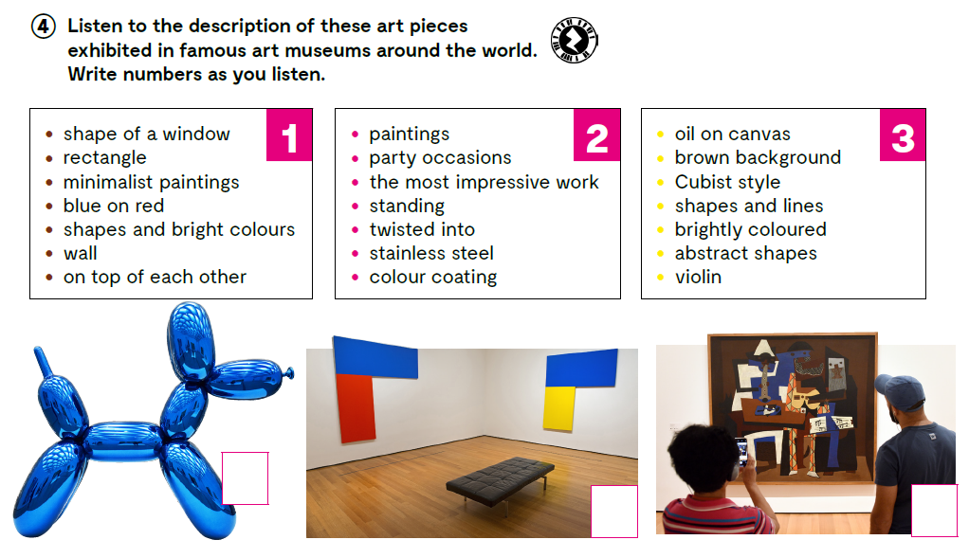
Listen to the description of these art pieces exhibited in famous art museums around the world. Write numbers as you listen https://www.e-sfera.hr/dodatni-digitalni-sadrzaji/86d8aea3-689a-4c83-b23a-236d1d1fb4d5/assets/audio/05_unit_2__lesson_1__exercise_4_5.mp3
2
1
3

Slide 13

Listen again and tick the phrases which are mentioned in each description. Choose one work and describe it. Do you remember the names of the artists? https://www.e-sfera.hr/dodatni-digitalni-sadrzaji/86d8aea3-689a-4c83-b23a-236d1d1fb4d5/assets/audio/05_unit_2__lesson_1__exercise_4_5.mp3
2
1
3

Slide 14
